Slide 1
2024-2025 ASBU YDYO ORYANTASYON PROGRAMI /ORIENTATION PROGRAM
Program Coordinator Damla Şahin

Slide 2
İÇİNDEKİLER / Content
KİTAP VE MATERYALLER / Books and Materials
PERİYOD DERS İÇERİĞİ / Content(Period)
ÖĞRENCİ DÖNEM DEĞERLENDİRME KRİTERLERİ / Assessment Elements
YAZMA DERSİ, ÖDEVLERİ / Writing Assignments
KONUŞMA ÖDEVİ / Speaking Assignment
MOODLE BİLGİLENDİRME / Moodle
ÇEVRİMİÇİ ÖDEV BİLGİLENDİRME / Online Assignment
ASBÜ Sosyal Medya / ASBU Social Media

Slide 3
KİTAPLAR/Coursebooks
BEGINNER& ELEMENTARY | ELEMENTARY/PRE-INTERMEDIATE | PRE-INTERMEDIATE
Speakout A1 Speakout A2 | Speakout A2 Speakout B1 | Speakout B1
North Star Listening and Speaking 1 | North Star Listening and Speaking 1 | North Star Listening and Speaking 2
My Grammar Lab | My Grammar Lab | My Grammar Lab
Okuma ve Dinleme Serbest Çalışma Kitapçığı ve ses dosyaları, dilbilgisi materyalleri ve diğer materyaller Moodle üzerinden gönderilecektir.
Reading & Listening self-study booklet and audios, grammar materials, writing booklets for intermediate and upper-intermediate level, and all the other supplementary materials will be shared on Moodle.
.

Slide 4
ÖRNEK PERİYOD DERS İÇERİĞİ / SAMPLE Period Content
2024-2025 INTERMEDIATE LEVEL STUDENT WEEKLY OUTLINE
WEEK | SPEAKOUT -intermediate | GRAMMAR MATERIAL/ GRAMMAR WORKSHEET | WRITING TASK | SPEAKING TASK | EXAM | Teacher Assessment | Pearson-myenglishlab assignments
1 | p.6- 18 |  | Writing BOOKLET: Error codes practice (page 31,32) NO TASKS | X | X | 1 See explanation 1 | 2 See explanation 2
2 | p.19-27 | Adjectives & Adverbs (Intensifiers) | Writing BOOKLET: Chapter 1: Introduction to Paragraph Writing NO TASKS | X | X
3 | p.28-38 | Linkers | Writing BOOKLET: Chapter 2: TASK 1: Opinion Paragraph GRADED |  | X
4 | p.38-47 |  | TASK 2: Writing response GRADED |  | Quiz 1
5 | p.48-57 |  | Writing BOOKLET: Chapter 3: TASK 3: Cause or Effect paragraph UNGRADED | Task 1: individual in-class presentation (assignment) GRADED | X
6 | p.58-64 | Noun Clauses | Writing BOOKLET: Chapter 4: TASK 4: Advantage or Disadvantage paragraph UNGRADED | Submission: Task 1 individual in-class presentation on Monday | X
7 | p.64-72 | Relative Clauses (Worksheet) | Writing BOOKLET: Chapter 5: TASK 5: Problem solution paragraph UNGRADED |  | Quiz 2
8 | p.72-85 |  | Writing BOOKLET: Chapter 6 -Revision |  | X
9 | End course | X | x | X | ECT

Slide 5
Dönem İçi Ödev ve Aktiviteler / CONTINUOUS ASSESSMENT ELEMENTS
 | Yazma ödevleri / Writing Assignments % | Konuşma Ödevi/ Speaking Assignment % | Online Ödevler / Online hw. % | QUIZ
ELE | 10 | 10 | 10 | 70
PIN | 10 | 10 | 10 | 70
PRE-INT | 10 | 10 | 10 | 70

Slide 6
Seviyeler İçin Performans Değerlendirme Unsurları
Hangi koşulda bir üst kura geçerim? | Hangi koşulda İngilizce Muafiyet Sınavına girebilirim?
Aşağıdaki değerlendirme unsurlarından en az 70 puan toplayarak Quizler (50%) + Performans değerlendirme unsurları (20%) | Aşağıdaki değerlendirme unsurlarından en az 70 puan toplayarak Quizler (50%) + Performans değerlendirme unsurları (20%)

Slide 7
How to pass the module? | How to be eligible to take the EPE
Collect at least 70 points from Quizzes (50%) + Continuous assessment elements (20%) | Collect at least 70 points from Quizzes (50%) + Continuous assessment elements (20%)

Slide 8
YAZMA DERSİ VE ÖDEVLERİ WRITING COURSES & TASKS

Slide 9
ELEMENTARY WRITING
Serbest yazma etkinlikleri /Free writing activities
Notlandırılan bir paragraf yazımı (one graded writing)
Sınıf içerisinde dönüt verilen haftalık yazma etkinlikleri (weekly writing activities with feedback)

Slide 10
PRE-INTERMEDIATE WRITING
Serbest yazma aktiviteleri /Free writing activities
Notlandırılan bir paragraf yazımı (one graded writing task)
Sınıf içerisinde dönüt verilen haftalık yazma etkinlikleri (weekly writing activities with feedback)

Slide 11
INTERMEDIATE WRITING
Paragraf Yazımı / Paragraph writing
Notlandırılan iki paragraf yazımı ( two graded writing tasks)
Notlandırılmayan üç paragraf yazımı (three ungraded writing tasks)

Slide 12
SÜREÇ (PROCESS)
NOTLANDIRILAN YAZMA ÖDEVLERİ
Salı /Tuesday: Sınıfda yazma (In-class writing)
Bir sonraki Salı (Next week on Tuesday): Hocadan dönüt alma/ feedback
NOTLANDIRILMAYAN YAZMA ÖDEVLERİ
Salı /Tuesday: Sınıfda yazma (In-class writing)
Bir sonraki ders (Next hour):Sınıfta dönüt alma/ feedback

Slide 13
Konuşma ödevleri/ SPEAKING TASKS
ELE | ELE-PRE | PRE-INT
Bireysel sınıf içi sunum | Bireysel sınıf içi sunum | Bireysel sınıf içi sunum
Individual in-class presentations for all levels

Slide 14
Öğretmen Değerlendirmesi/ Instructor’s Grade
GRADE | PERFORMANCE | GRADE | ATTITUDE
5 | All assignments are submitted on time. The assignments always reflect high effort on the part of the student. The student always participates actively in class activities. The student performs tasks to his/her best using English during the process. | 5 | The student comes to class on time every day with all the necessary books, materials and stationery. (S)He always shows a positive attitude towards work and instructor, and he is very eager to learn English. S (H)e never distracts anyone in the class.
4 | Almost all assignments are submitted on time. The assignments usually reflect high effort on the part of the student. The student usually participates actively in class activities. The student performs tasks comprehensively using English as much as possible with very minor use of Turkish. | 4 | The student mostly comes to class on time with all the necessary books, materials and stationery. (S)He shows a positive attitude towards work and instructor most of the time. S (H)e does not distract anyone in the class.
3 | Most assignments are submitted on time. The assignments reflect satisfactory effort on the part of the student. The student tries to participate in class activities most of the time. (S)He tries to perform tasks well using English most of the time with short intervals of Turkish. | 3 | The student usually comes to class on time and rarely forgets books, materials and stationery. The student usually shows a positive attitude towards work and instructor without causing any problems in the class.
2 | Some assignments are incomplete or not submitted on time. There is a lack of effort to do the tasks well. The student participates in class activities to some extent &or distracted &or often uses Turkish | 2 | The student sometimes comes to class after the instructor and sometimes forgets books, materials and stationery. The student shows a neutral attitude towards work and instructor. (S)He sometimes distracts others.
1 | The student does little homework. S (H)e rarely participates in class activities and insists on speaking Turkish. | 1 | The student is usually late for classes. S (H)e usually comes to classes without the required materials. S (H)e usually distracts the others in class and shows a negative attitude towards work and instructor.
0 | The student does no homework. S(H)e does not participate in class activities & or uses Turkish most of the time in the classes | 0 | The student always disturbs class atmosphere or he is disrespectful to others in the class. S (H)e always comes to classes late or shows no presence at all. S (H)e always comes to class without the required materials.

Slide 15
Moodle
Seviyelere ve sınıflara göre çevrimiçi sınıflar açılacaktır.
Dersle ilgili duyurular ve her türlü materyal paylaşımı bu platformdan yapılacaktır.
At all levels, virtual classes will be formed on Moodle and all
announcements and material sharing will be done on Moodle.

Slide 16
ÇEVRİMİÇİ ödev/ myenglishlab homework
Bu süreç için nelere ihtiyacınız var?
Orjinal kitap
Orjinal kitaptaki giriş kodu
My English Lab kayıt süreci hakkında bilgilendirme & sınıf kaydı için gerekli giriş kodu
What do you need for the process?
The original book
Access code in the original book
Information about My English Lab registration process & Course ID
You need to buy original books so that you have the chance to do online homework and get %10 out of 100 as part of the continuous assessment elements
The process will be shared with you in details

Slide 17
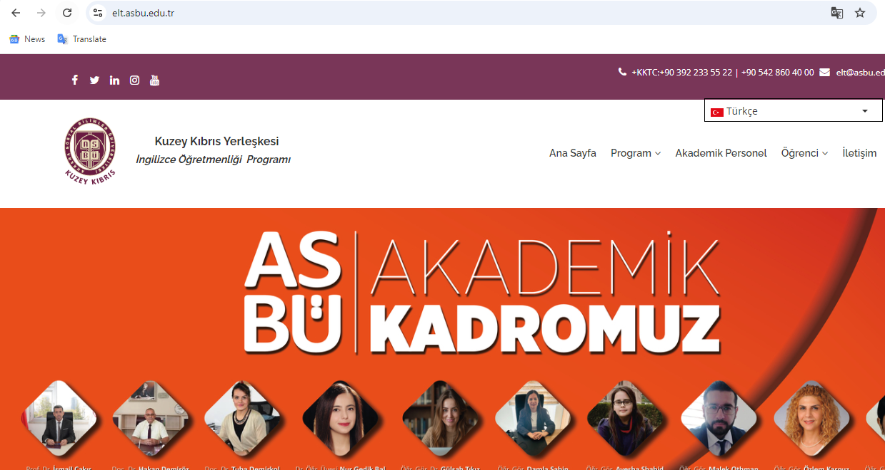
ASBÜ YDY / ASBÜ SFL OFFICIAL Social Media Accounts

Slide 18
